Slide 1




Employing crowdsourcing & readability indexes for revising Patient Information Leaflets for Randomized Controlled Trials
Fernando Santos fss1g15@soton.ac.uk
Supervisors:
Jeremy Wyatt j.c.wyatt@soton.ac.uk
Thanassiss Tiropanis t.tiropanis@southampton.ac.uk
Adam Geraghty a.w.geraghty@soton.ac.uk

Slide 2





Disclosure
Nothing to disclose, I have not received any monetary compensation nor do I have financial or commercial association to any entities at the time of the presentation.
Mirjam Nilsson
Jens Martensson
August Berggren
Co-Owner / Specialist
Co-Owner / Marketing
Surgeon
Ian Karlsson
Victoria Nilsson
Sales
CFO

Slide 3
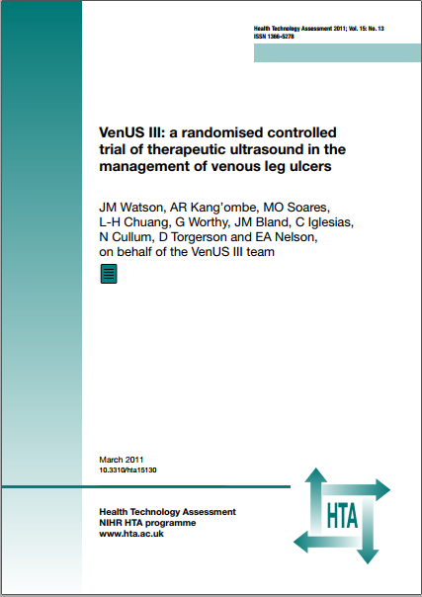
Background
Patient Information Leaflets (PILs) are an essential part of informed consent for participants of Randomized Controlled Trials (RCTs).
Current guidelines by the Health Research Authority (HRA) follow a “proportionate approach to seeking consent”.
The HRA approach gives flexibility in content and design based on the risk to the patient.
Trialists attempt to ensure readability is done by following HRA template and engaging Patient and Public Involvement (PPI) groups when required.
Mirjam Nilsson
Jens Martensson
August Berggren
Co-Owner / Specialist
Co-Owner / Marketing
Surgeon
Ian Karlsson
Victoria Nilsson
Sales
CFO

Slide 4






Current position & results
“The participant information sheet should support the consent process by helping to ensure that all those who are invited to take part in a research study have been adequately informed”
—MRC 2016
34%
14%
Public involvement definition
PPI groups
£25 per hr.
Of PIL content is too hard to understand*
Of PILs contain severe readability issues
Restricts researcher from assessing reader understanding
No standardized process
No definition of impact
Inadequate reporting
Recommended INVOLVE payment
Low quality PIL information
3

Slide 5

Research Methodology
Analysing the associations between PIL characteristics, RCT recruitment and participant demographics.
Analysing public feedback to PILs with known serious readability issues, participant understanding and perception of information quality.
Analysing the effect of employing crowdsourcing and content analysis to identify, revise and validate readability issues
4

Slide 6


First study: Analysing the characteristics of PIL text
Description
Methodology
Associations between trial settings and PIL readability
Cross-sectional observational study of the readability and textual characteristics of 58 RCT PILs supported by the HTA between 2000-2014.
A selection of 58 trials with publicly available PILs intended to inform the consenting participant of an RCT were selected from a set of 181 clinical trial records provided by the NHIR main coordinate center (NETSCC)
The study analysed the associations between trial settings (sample size, duration, recruitment and trial classification), PIL text characteristics (number of words, characters, syllables and sentences) and PIL readability scores (SMOG, Flesch-Kincaid, ARI, Coleman-Liau).
Association between readability and recruitment
Consistency of readability indexes
Emotion in PILs
The study found significant correlations between PIL readability and RCT recruitment, other factors found were number of recruiting centers, emotion words (joy, negative), increasing sample size and being a trial on drug intervention or evaluating a treatment
When group by research area or trial type, the PILs demonstrated large variances in their text characteristics but all readability indexes gave consistent measurements (requiring above the recommended 10th grade education maximum).
A comparison to anchor the emotive scales was made with news articles in the BBC, Daily Mail and Hello Magazine, it was found PILs contain more words related to positive emotions than this media and less emotive variance.

Slide 7
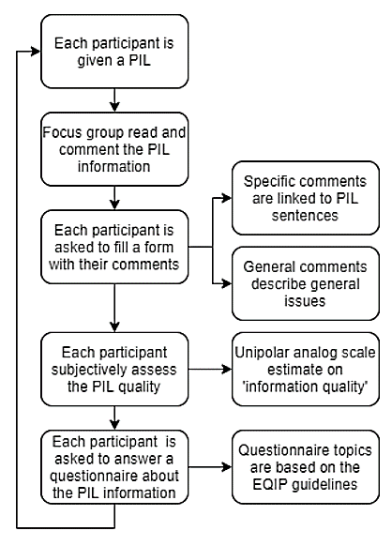
Second study: Analysing public feedback on PIL

Slide 8
Second study: Analysing public feedback on PIL
Description
Methodology
Significant difference in understanding based on education level
Cross-sectional observational study of 2 focus groups (5 participants per group) for each education level (GCSEs, Undergrad, Graduate) revising 4 PILs with known severe readability issues
Employ focus groups to review PILs with known severe readability issues from the first study
Assess the participant perception of quality via qualitative metrics
Assess the participants understanding via a quantitative questionnaire (EQIP).
The GSCE educated group average score was 22% correct answers (s.d. 4.2) vs scores of 54% (s.d. 6.8) and 65% (s.d. 6) for the A-Levels and Graduate groups respectively.
Analysing the participant perception of quality
Analysing the participant understanding
Analysing public feedback to PILs with severe readability issues
85% of GCSE group correctly identified issues in PILS with severe known readability issues, versus only 32% of A-level and 23% of graduate groups.
Participant understanding was found to be associated with education level and PIL readability, but not with their perception of PIL quality or subjective comments
6 focus groups (2 for each education level: GCSE, Undergrad, Graduate) with similar tasks and format to a PPI group
Only specific comments intended to correct specific issues were found to be associated to the understanding of the information
7

Slide 9
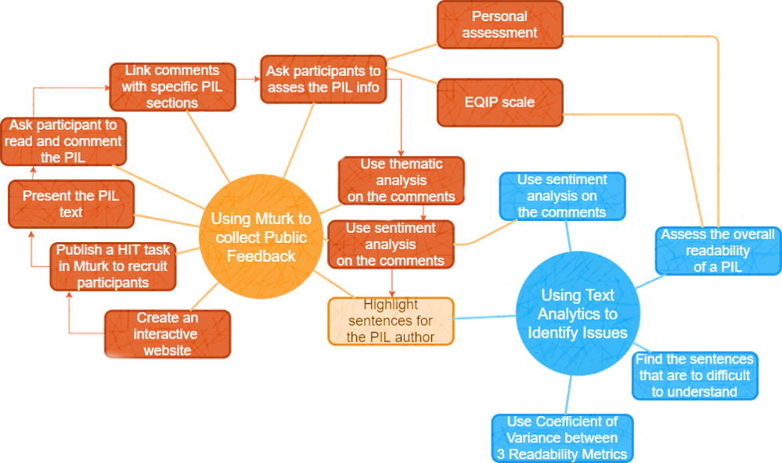
Third study: Revising PILs via crowdsourcing and content analysis
8

Slide 10
Third study: Revising PILs via crowdsourcing and content analysis
Description
Methodology
34% of the PILs sentences are too hard to understand by potential RCT recruits
A Web based non-clinical randomised experiment on the use of crowd sourcing and content analysis to identify, revise and validate readability issues in currently in-use PILs.
Employing 30 public participants to review 3 PILs through a Webtool
Employing 117 participants to revise 27 sentences that were hard to understand
Employing 32 participants to select the best revision to the original sentence
A sentence was judged too hard to understand if it was longer than 15 words and 3 readability indexes marked it as requiring more than 9th grade education
Employing crowdsourcing improved readability by 2.5 grades
Validating revisions with crowdsourcing
677 sentence revisions were provided by 117 participants for 27 original PIL sentences. A median reduction of 2.5 readability grades was noted [IQR 0.6 to 4.9].
A one-way Anova test was used to find significant differences in the grades given to proposed revisions. 2,394 valid scores submission were collected from 32 participants for 9 revisions for each sentence, in 2 cases the participants showed preference for a revision.
9

Slide 11




Our proposed methodology to revise PILs
05
Reassess PIL readability
with readability indexes and participant understanding questionnaires
Progression of PIL revision
Crowdsource identification
of the best revisions, present feedback to authors and create a new PIL version
Crowdsource revising
03
the identified sentences assessing participant understanding and ability
Identify sentences
02
that are too hard to be easily understood
01
Assess PIL readability
with readability indexes
Day 1
Days 2-5
Day 6-10
10

Slide 12

Thank you
Fernando Santos
PhD Student
fss1g15@soton.ac.uk
University of Southampton, WAIS group

